Slide 1

The SBCC Summit encourages you to use the Better Poster design to communicate your findings in the best possible format.
Templates and examples available on the following slides. Read more about the Better Poster here https://www.npr.org/sections/health-shots/2019/06/11/729314248/to-save-the-science-poster-researchers-want-to-kill-it-and-start-over or here https://convention.apa.org/blog/rethinking-the-science-poster.

Slide 2
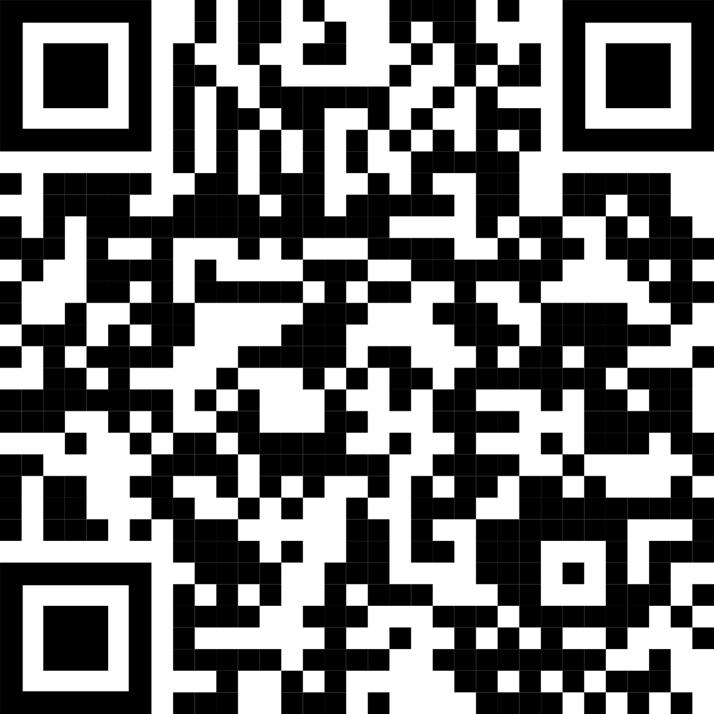
Main finding goes here, translated into plain English. Emphasize the important words.
Title:
Subtitle
Title goes here; make it small if you need to free up space.
AMMO BAR
Delete this and replace it with your…
Extra Graphs
Extra Correlation tables
Extra Figures
Extra nuance that you’re worried about leaving out.
Keep it messy! This section is just for you.
Additional info
INTRO
Just give context for the gap you’re filling
You’re not going to get yelled at if you don’t cite the 5 papers from 1937 that defined this construct. They’ll download your paper if they want that.
Additional info
METHODS
N = ###,
Collected this
Tested with X statistical test
Additional info
Additional info
RESULTS
Graph or table with essential results only.
All the other correlations in the ammo bar.
Additional info
Additional info
DISCUSSION
“If this result actually generalized and I didn’t have to humbly disclaim the possibility of a thousand confounds and limitations, it would imply that….”
Additional info
Keep font size as high above 28 as possible.
Easily create your own QR code here: https://www.qrcode-monkey.com
Leeroy Jenkins, author2, author3, author4
Take a picture to
download the full paper

Slide 3
Main finding goes here, translated into plain English. Emphasize the important words.
Title:
Subtitle
Title goes here; make it small if you need to free up space.
AMMO BAR
Delete this and replace it with your…
Extra Graphs
Extra Correlation tables
Extra Figures
Extra nuance that you’re worried about leaving out.
Keep it messy! This section is just for you.
Additional info
INTRO
Just give context for the gap you’re filling
You’re not going to get yelled at if you don’t cite the 5 papers from 1937 that defined this construct. They’ll download your paper if they want that.
Additional info
METHODS
N = ###,
Collected this
Tested with X statistical test
Additional info
Additional info
RESULTS
Graph or table with essential results only.
All the other correlations in the ammo bar.
Additional info
Additional info
DISCUSSION
“If this result actually generalized and I didn’t have to humbly disclaim the possibility of a thousand confounds and limitations, it would imply that….”
Additional info
Keep font size as high above 28 as possible.
Easily create your own QR code here: https://www.qrcode-monkey.com
Leeroy Jenkins, author2, author3, author4
Take a picture to
download the full paper

Slide 4
Main finding goes here, translated into plain English. Emphasize the important words.
Title:
Subtitle
Title goes here; make it small if you need to free up space.
AMMO BAR
Delete this and replace it with your…
Extra Graphs
Extra Correlation tables
Extra Figures
Extra nuance that you’re worried about leaving out.
Keep it messy! This section is just for you.
Additional info
INTRO
Just give context for the gap you’re filling
You’re not going to get yelled at if you don’t cite the 5 papers from 1937 that defined this construct. They’ll download your paper if they want that.
Additional info
METHODS
N = ###,
Collected this
Tested with X statistical test
Additional info
Additional info
RESULTS
Graph or table with essential results only.
All the other correlations in the ammo bar.
Additional info
Additional info
DISCUSSION
“If this result actually generalized and I didn’t have to humbly disclaim the possibility of a thousand confounds and limitations, it would imply that….”
Additional info
Keep font size as high above 28 as possible.
Easily create your own QR code here: https://www.qrcode-monkey.com
Leeroy Jenkins, author2, author3, author4
Take a picture to
download the full paper

Slide 5
Main finding goes here, translated into plain English. Emphasize the important words.
Title:
Subtitle
Title goes here; make it small if you need to free up space.
AMMO BAR
Delete this and replace it with your…
Extra Graphs
Extra Correlation tables
Extra Figures
Extra nuance that you’re worried about leaving out.
Keep it messy! This section is just for you.
Additional info
INTRO
Just give context for the gap you’re filling
You’re not going to get yelled at if you don’t cite the 5 papers from 1937 that defined this construct. They’ll download your paper if they want that.
Additional info
METHODS
N = ###,
Collected this
Tested with X statistical test
Additional info
Additional info
RESULTS
Graph or table with essential results only.
All the other correlations in the ammo bar.
Additional info
Additional info
DISCUSSION
“If this result actually generalized and I didn’t have to humbly disclaim the possibility of a thousand confounds and limitations, it would imply that….”
Additional info
Keep font size as high above 28 as possible.
Easily create your own QR code here: https://www.qrcode-monkey.com
Leeroy Jenkins, author2, author3, author4
Take a picture to
download the full paper

Slide 6
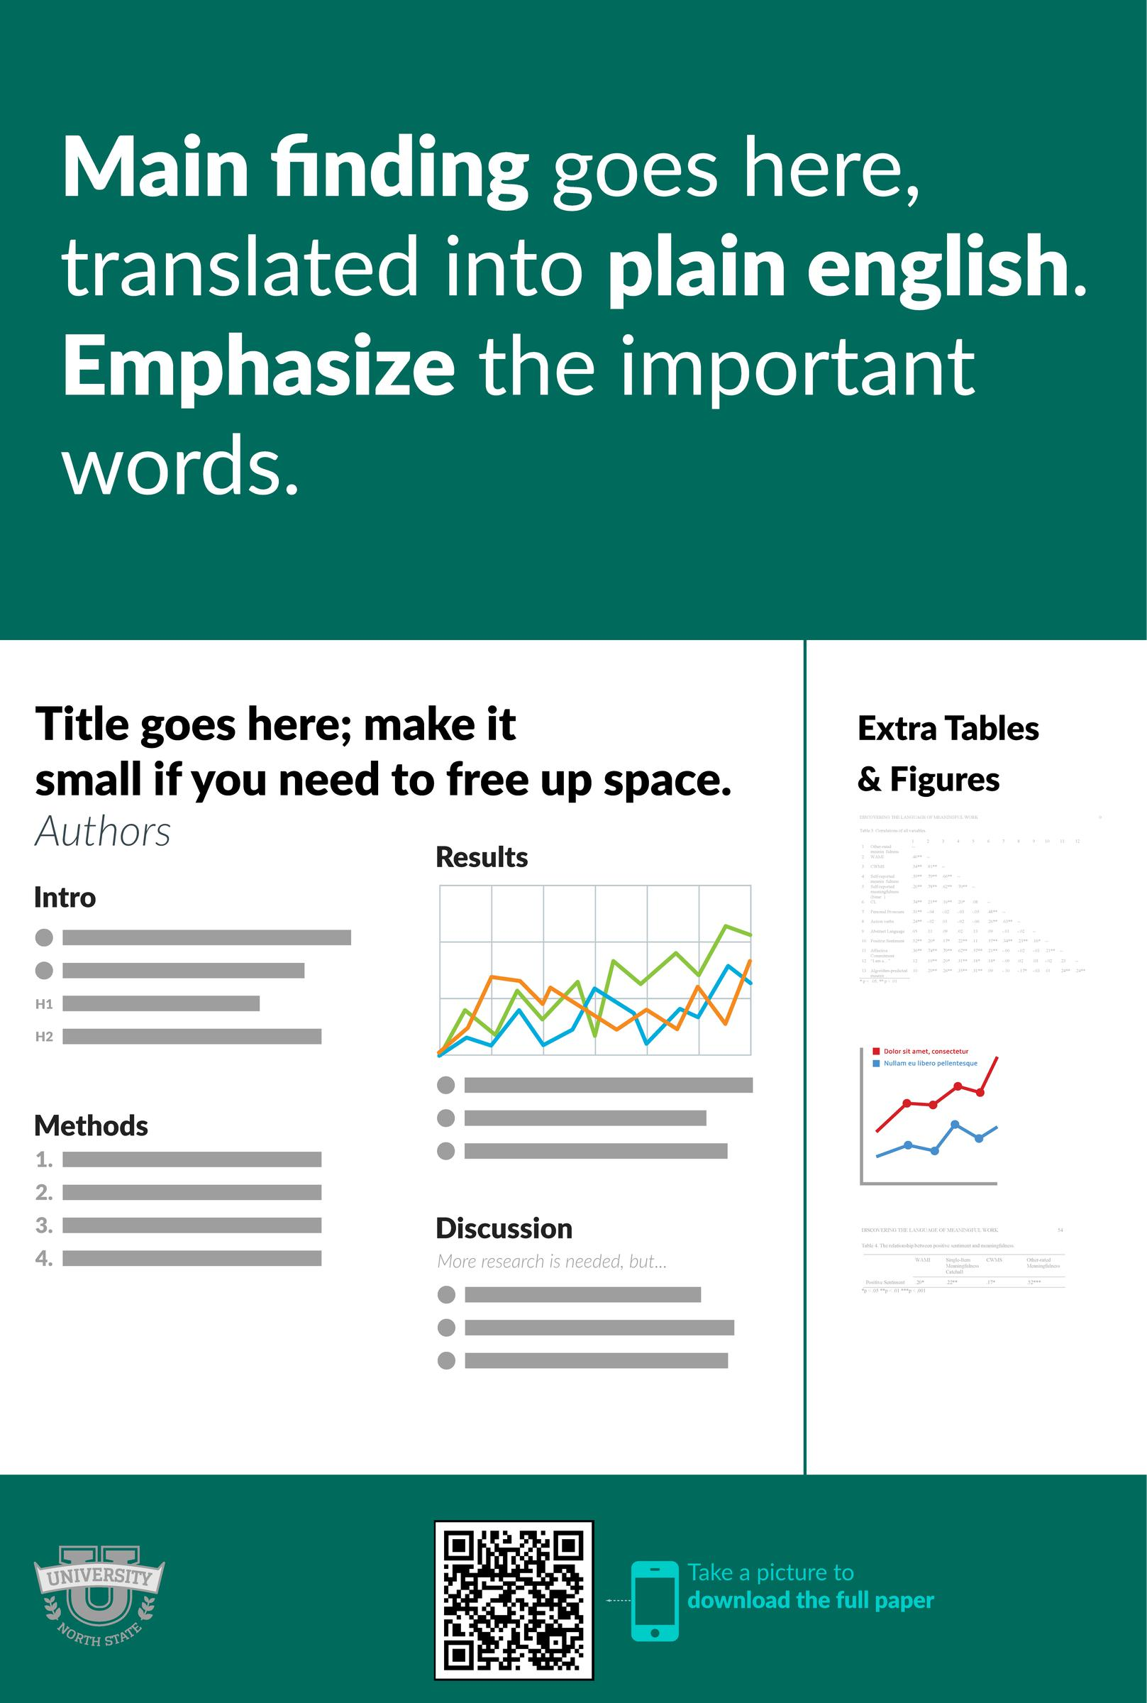
Example by Mike Morrison

Slide 7
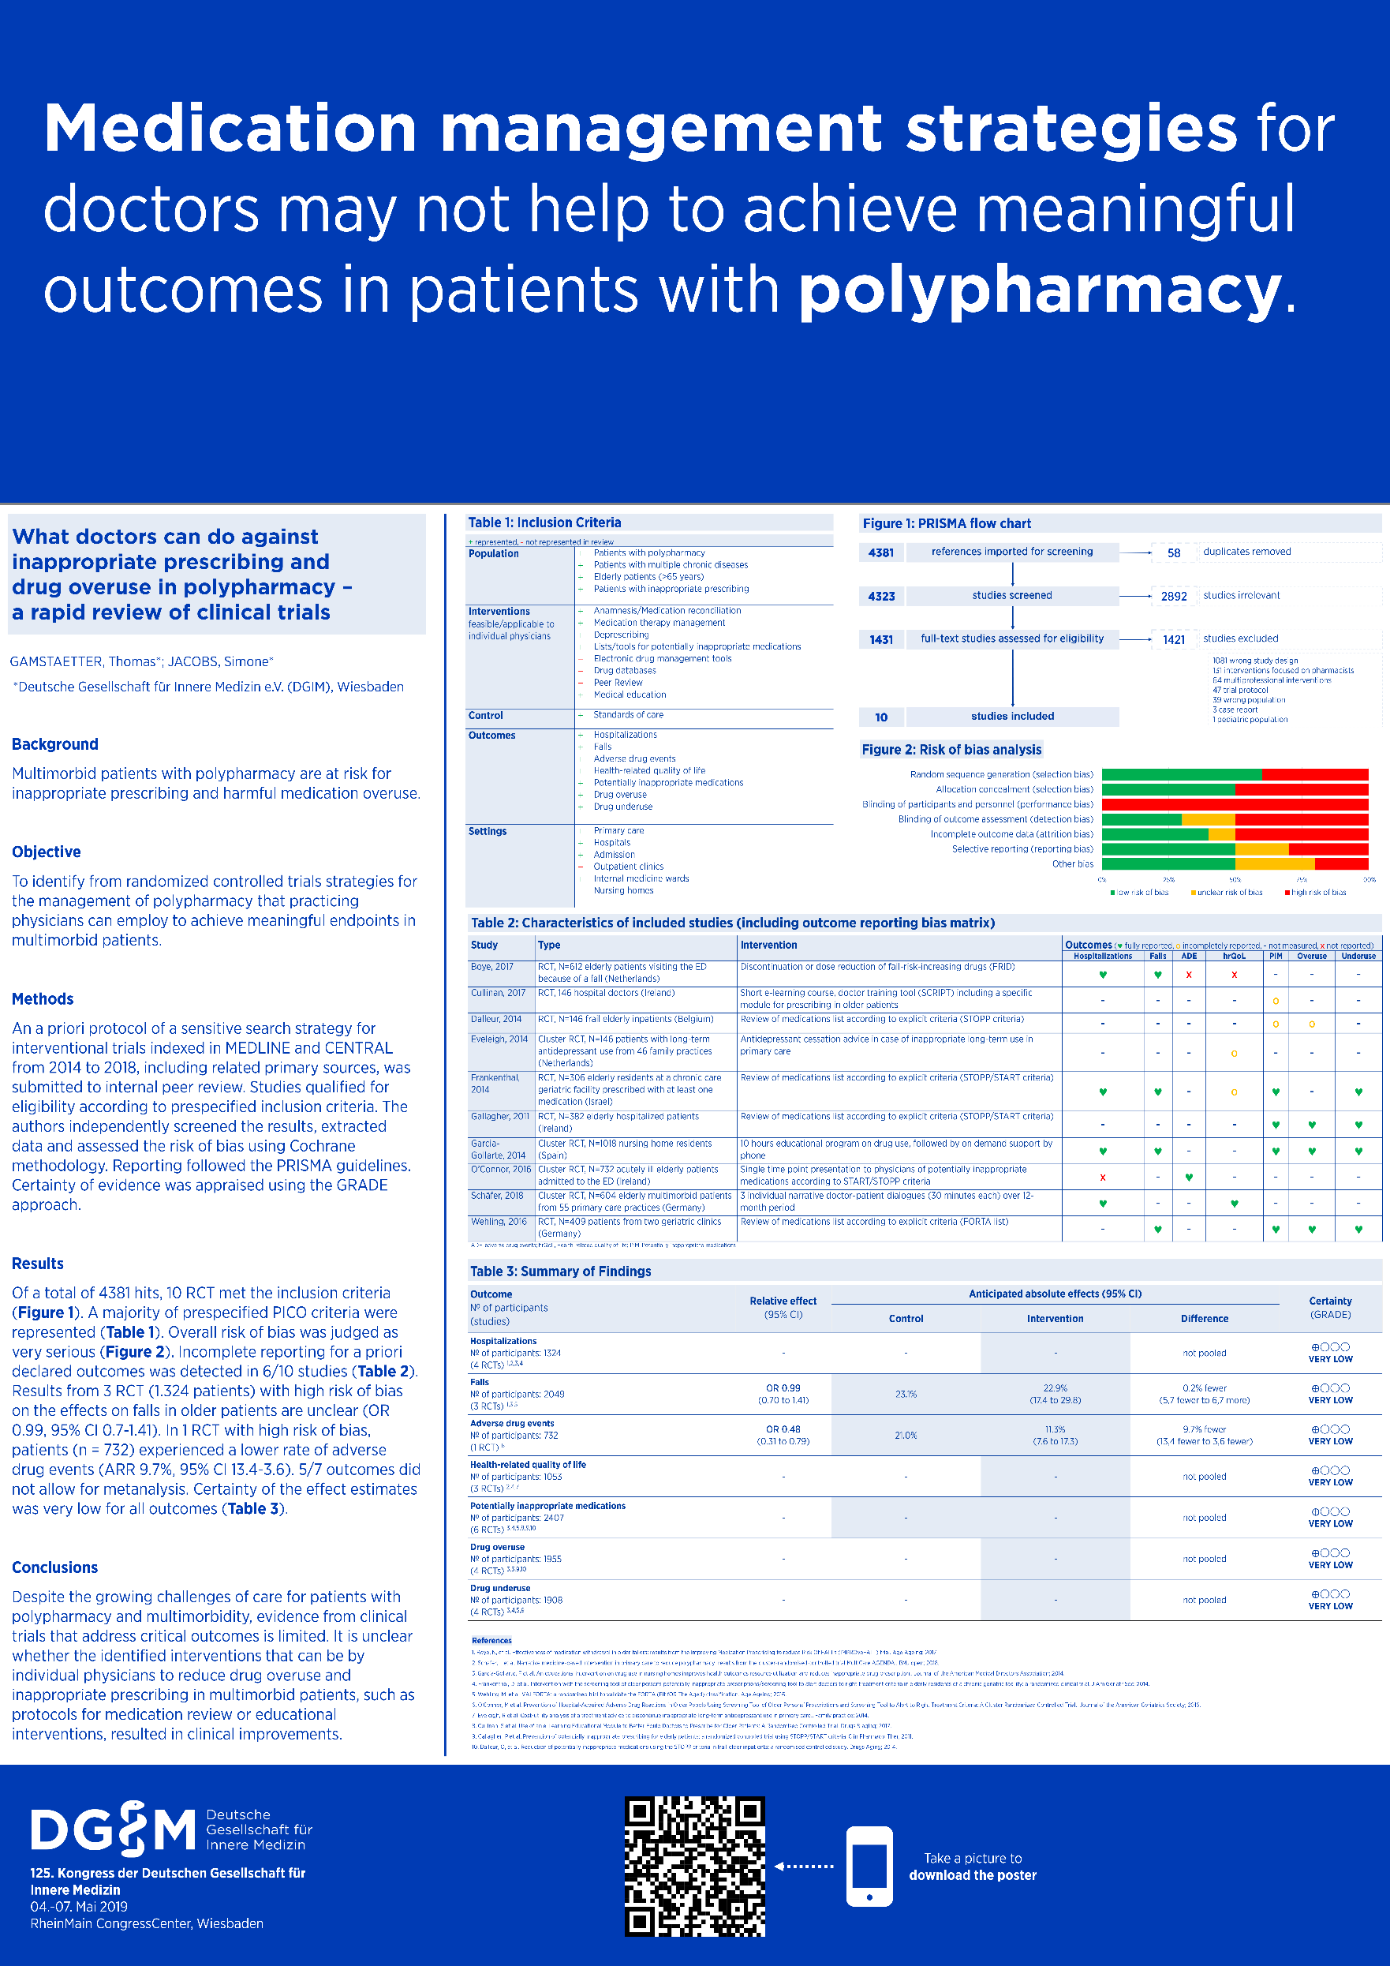
Example by Dr. Thomas Gamstätter

Slide 8
Notes:
1. Generate a QR code so viewers can access your full paper, abstract or more here: https://www.qrcode-monkey.com/
2. If you don’t want to use a QR code, create a short URL using Bitly or TinyURL instead: https://tiny.cc/
3. Find free icons for your poster here: www.nounproject.com
4. Love the Better Poster? Watch more here: https://www.youtube.com/watch?v=1RwJbhkCA58

